Slide 1

spender app IGP Project
Marvin Agbor
Adetola Bamigbala
Rachanon Chomphoo
Siraj Din

Slide 2

Research and Methodology

Slide 3
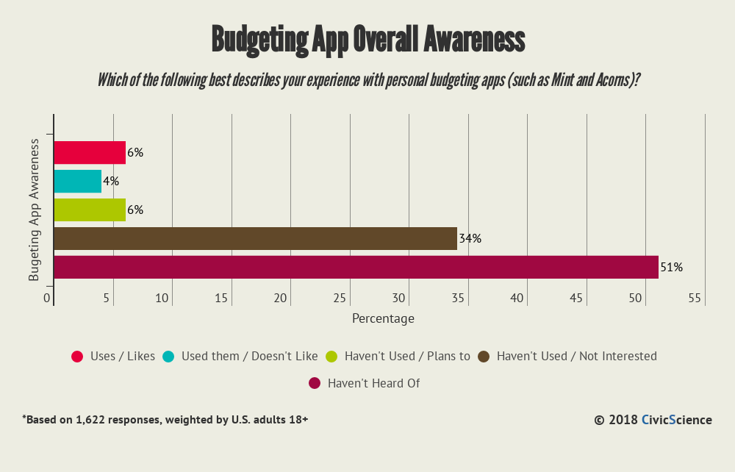

Slide 4
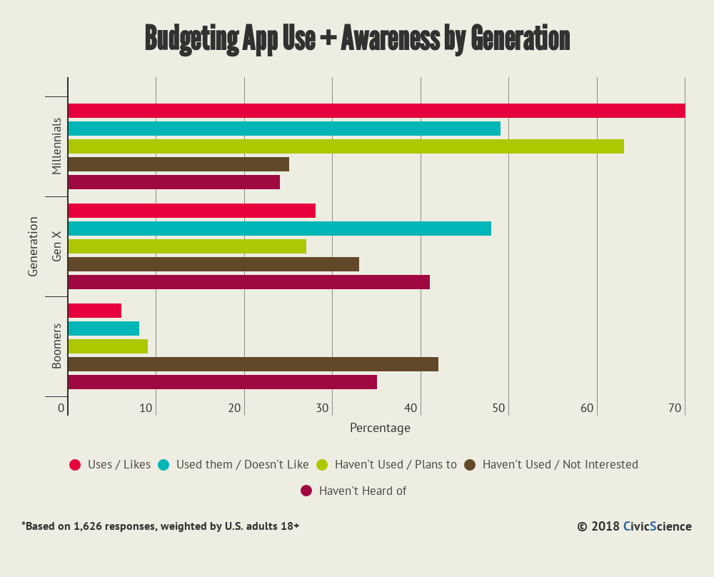

Slide 5
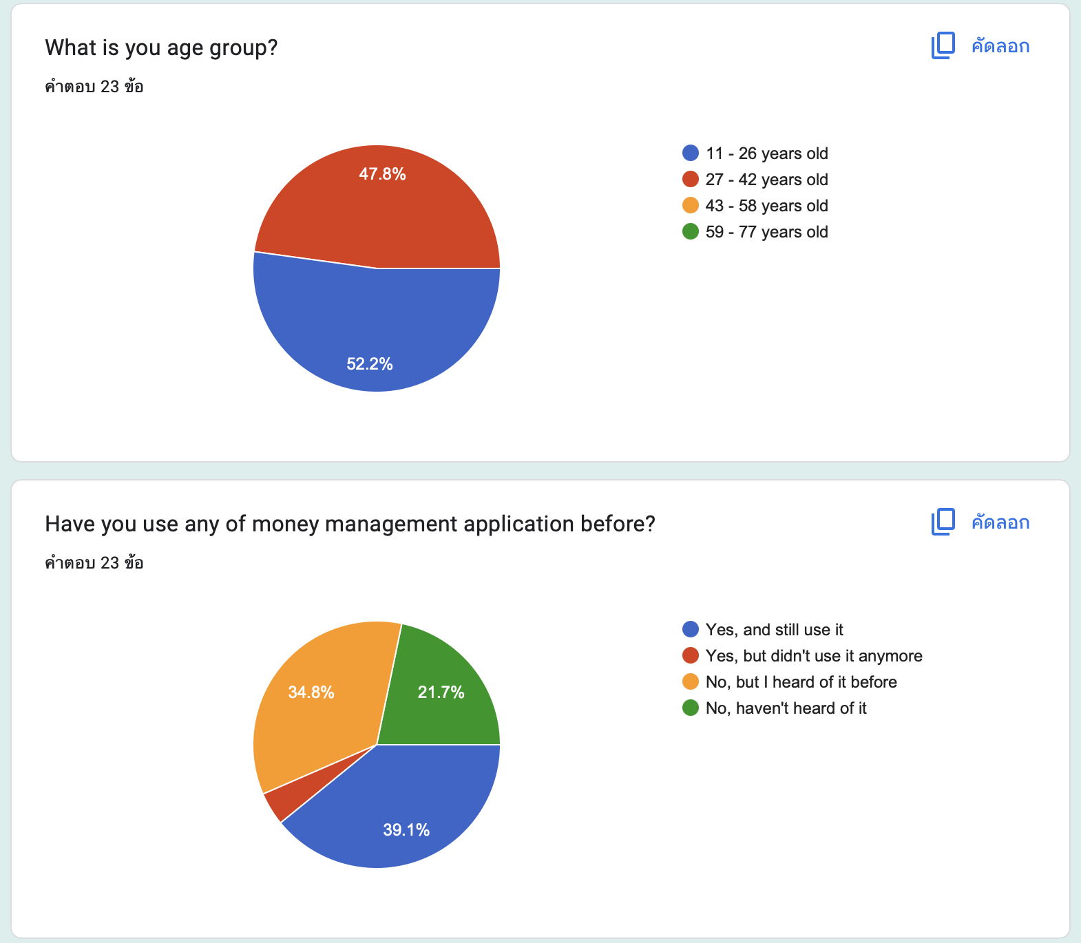
Survey

Slide 6
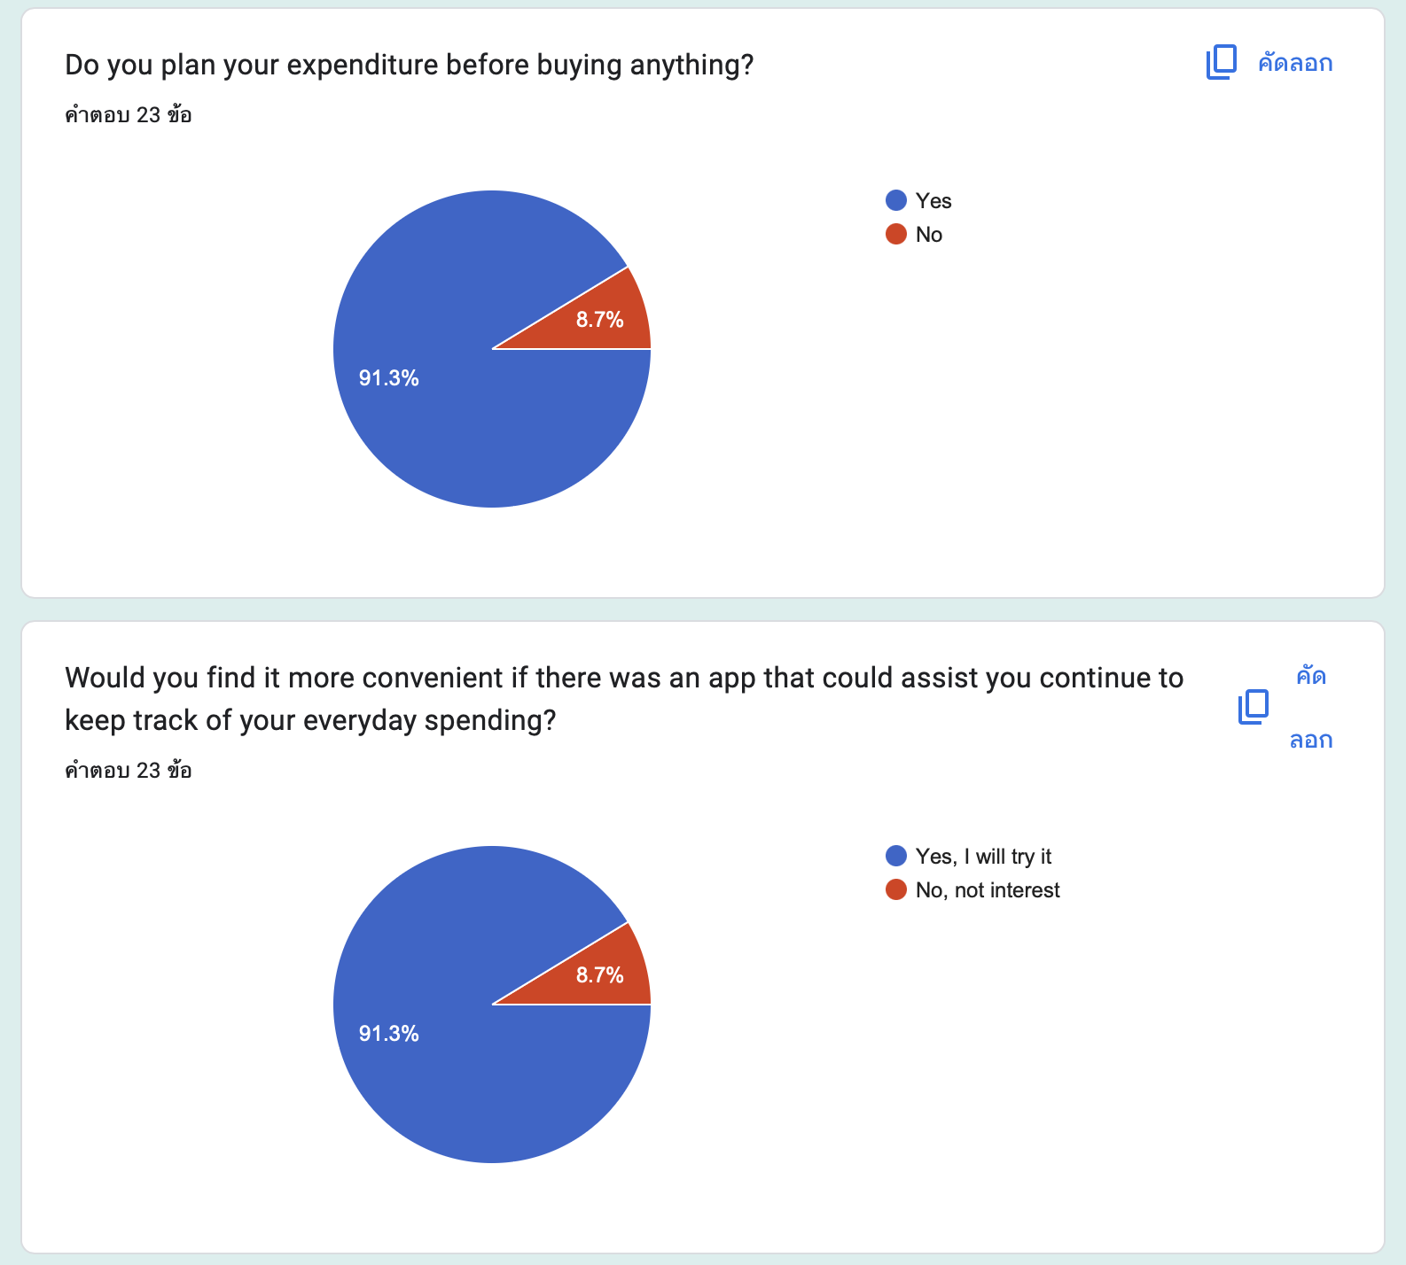
Survey

Slide 7
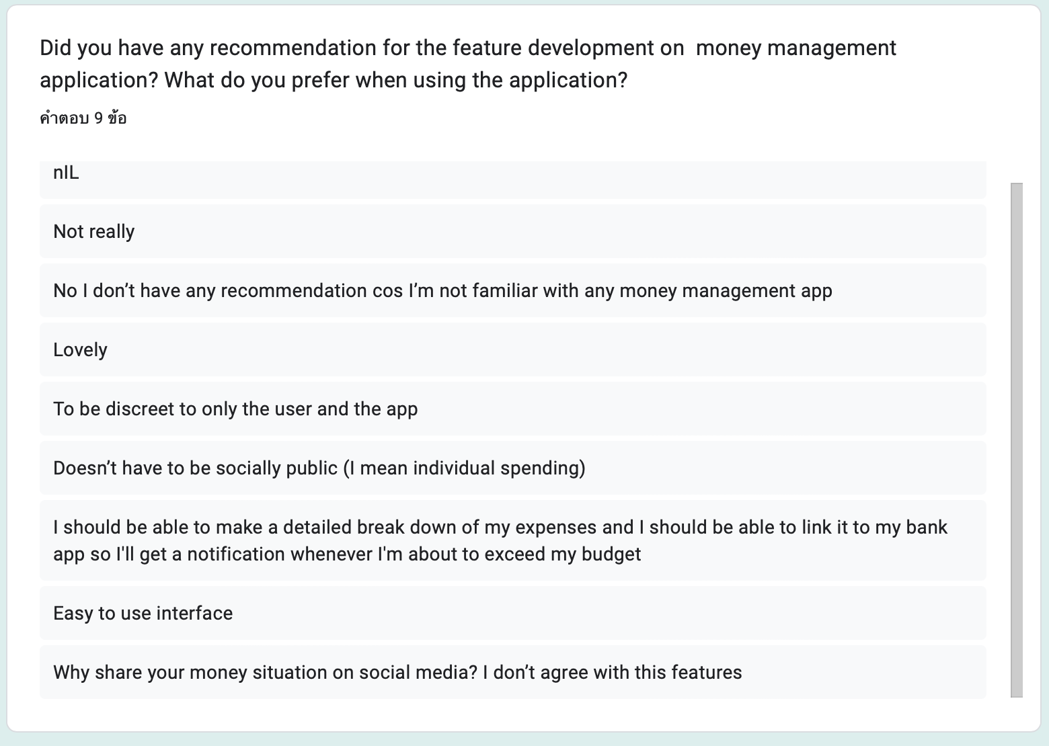
survey

Slide 8

Project management

Slide 9
PROJECT MANAGEMENT
App Developer (Siraj Din)
Research & Coordinator (Marvin Agbor)
Coordinator & Survey gathering
(Adetola Bamigbala)
Meeting caller, Research & Report (Rachanon Chomphoo)

Slide 10
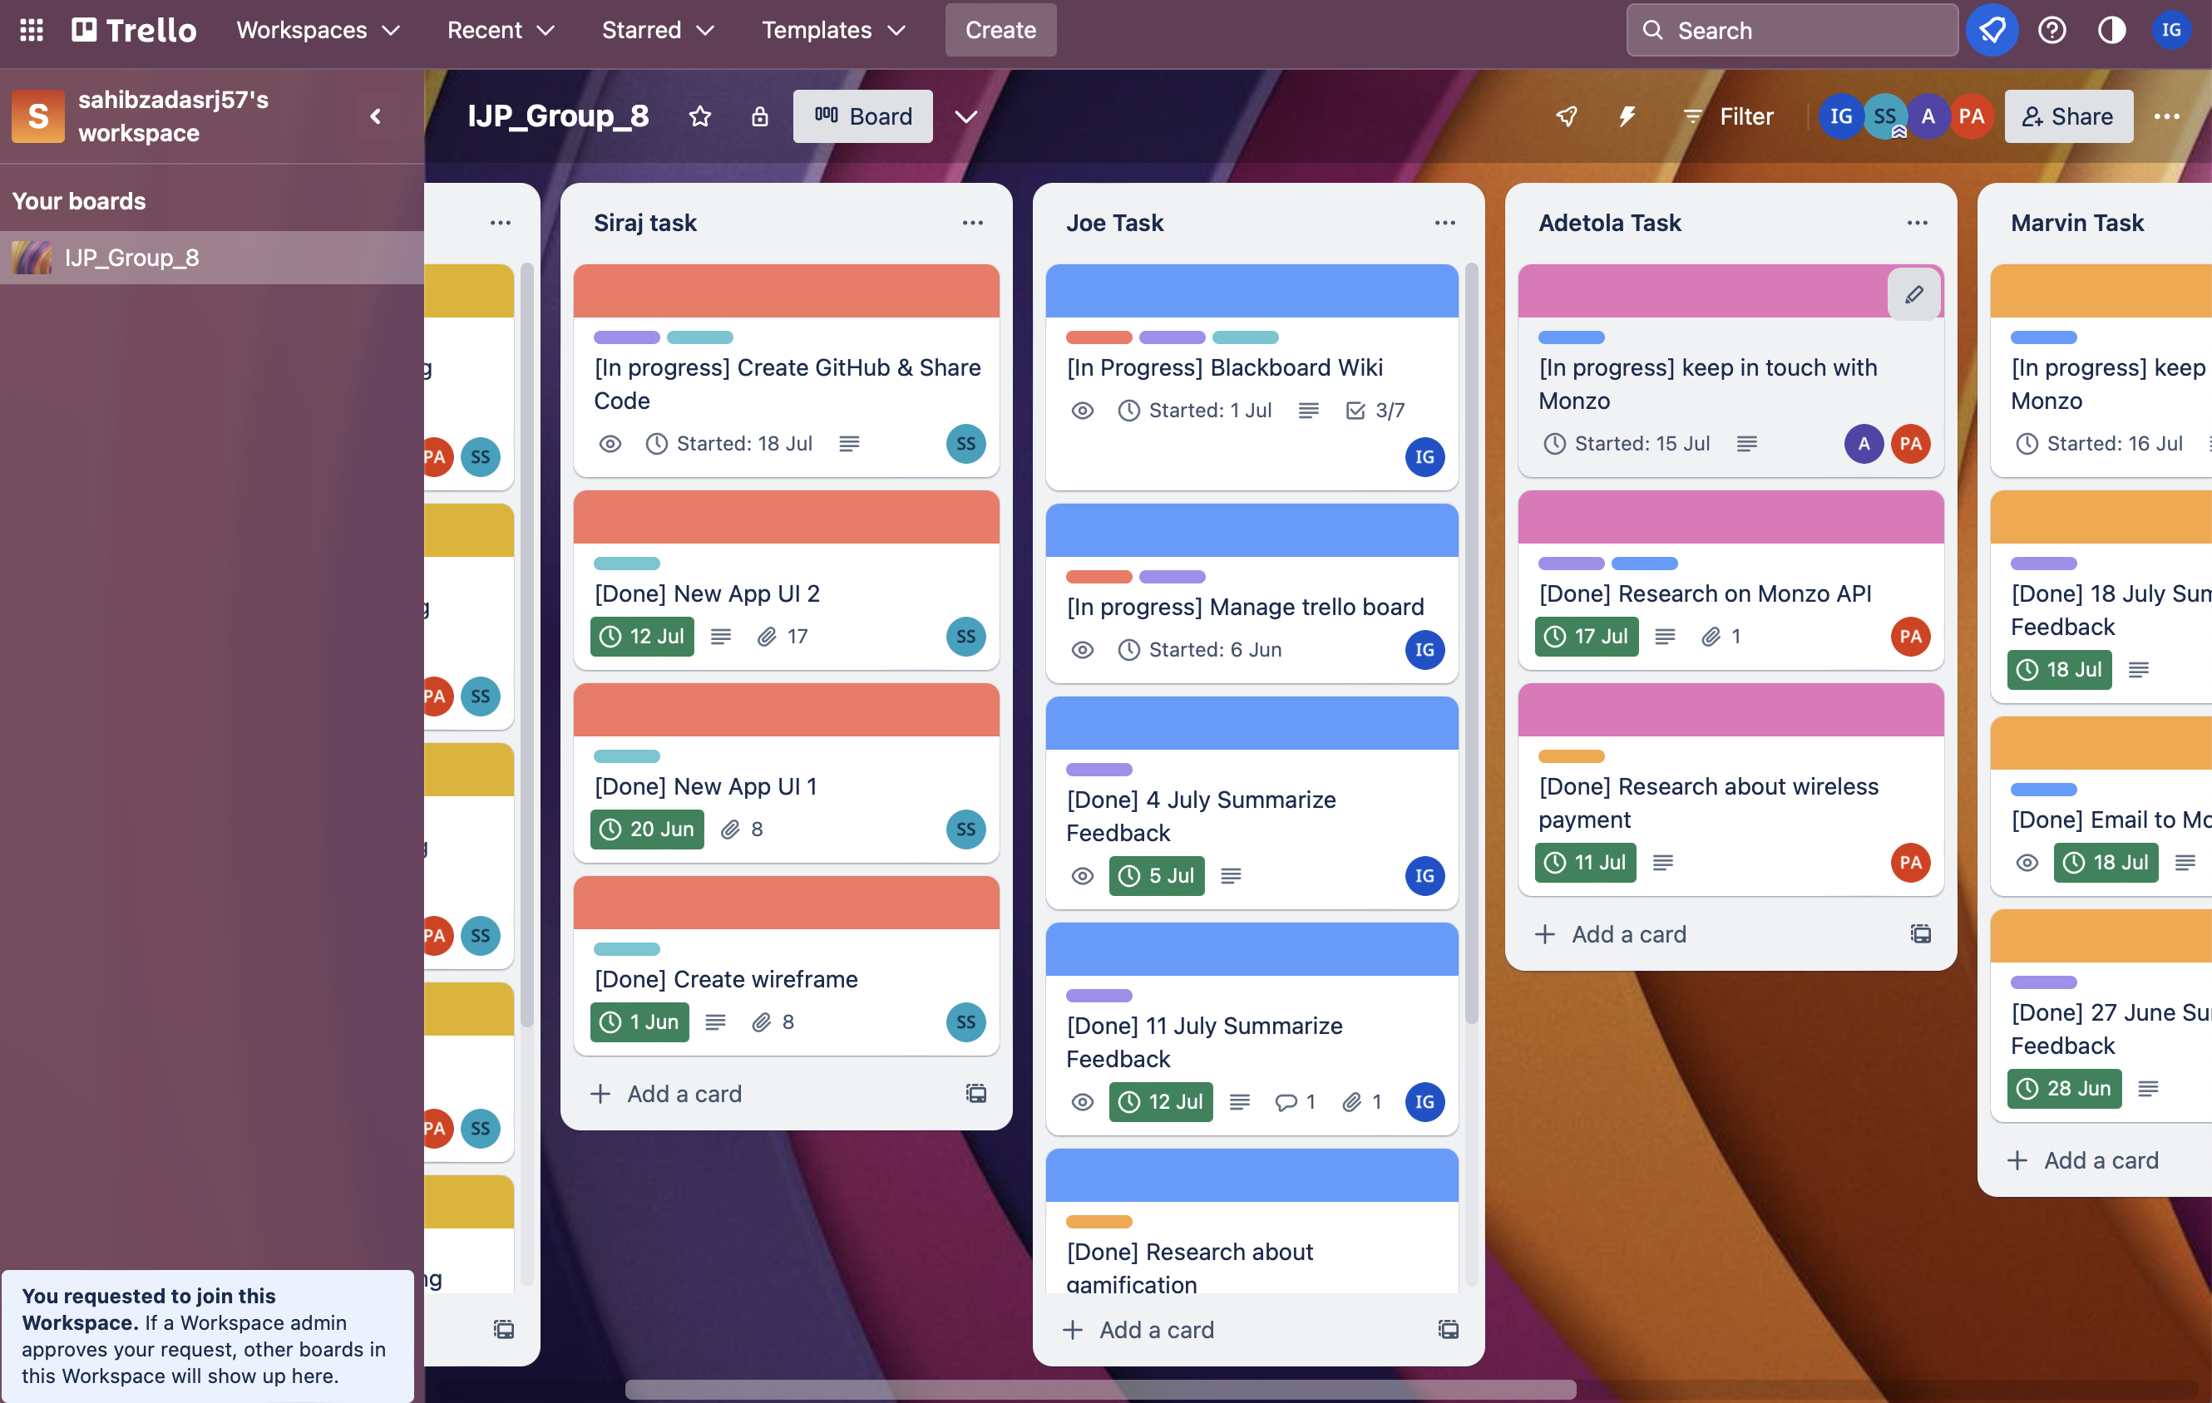


Slide 11

Technical implementation

Slide 12
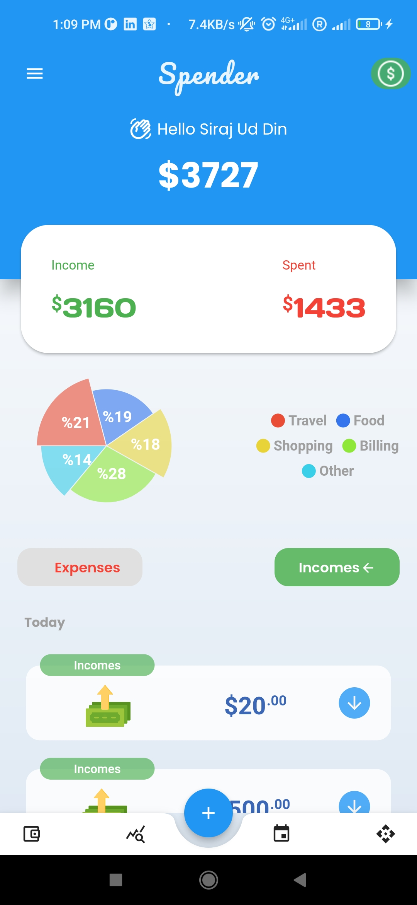
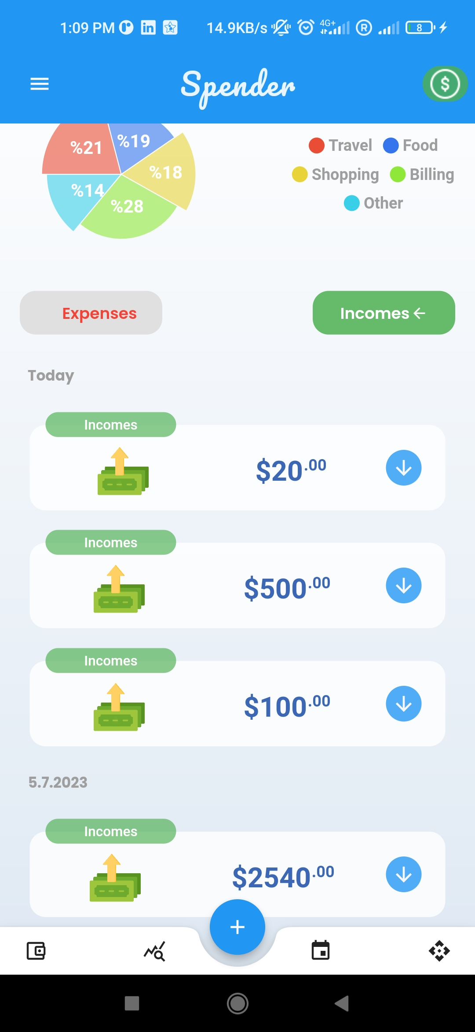
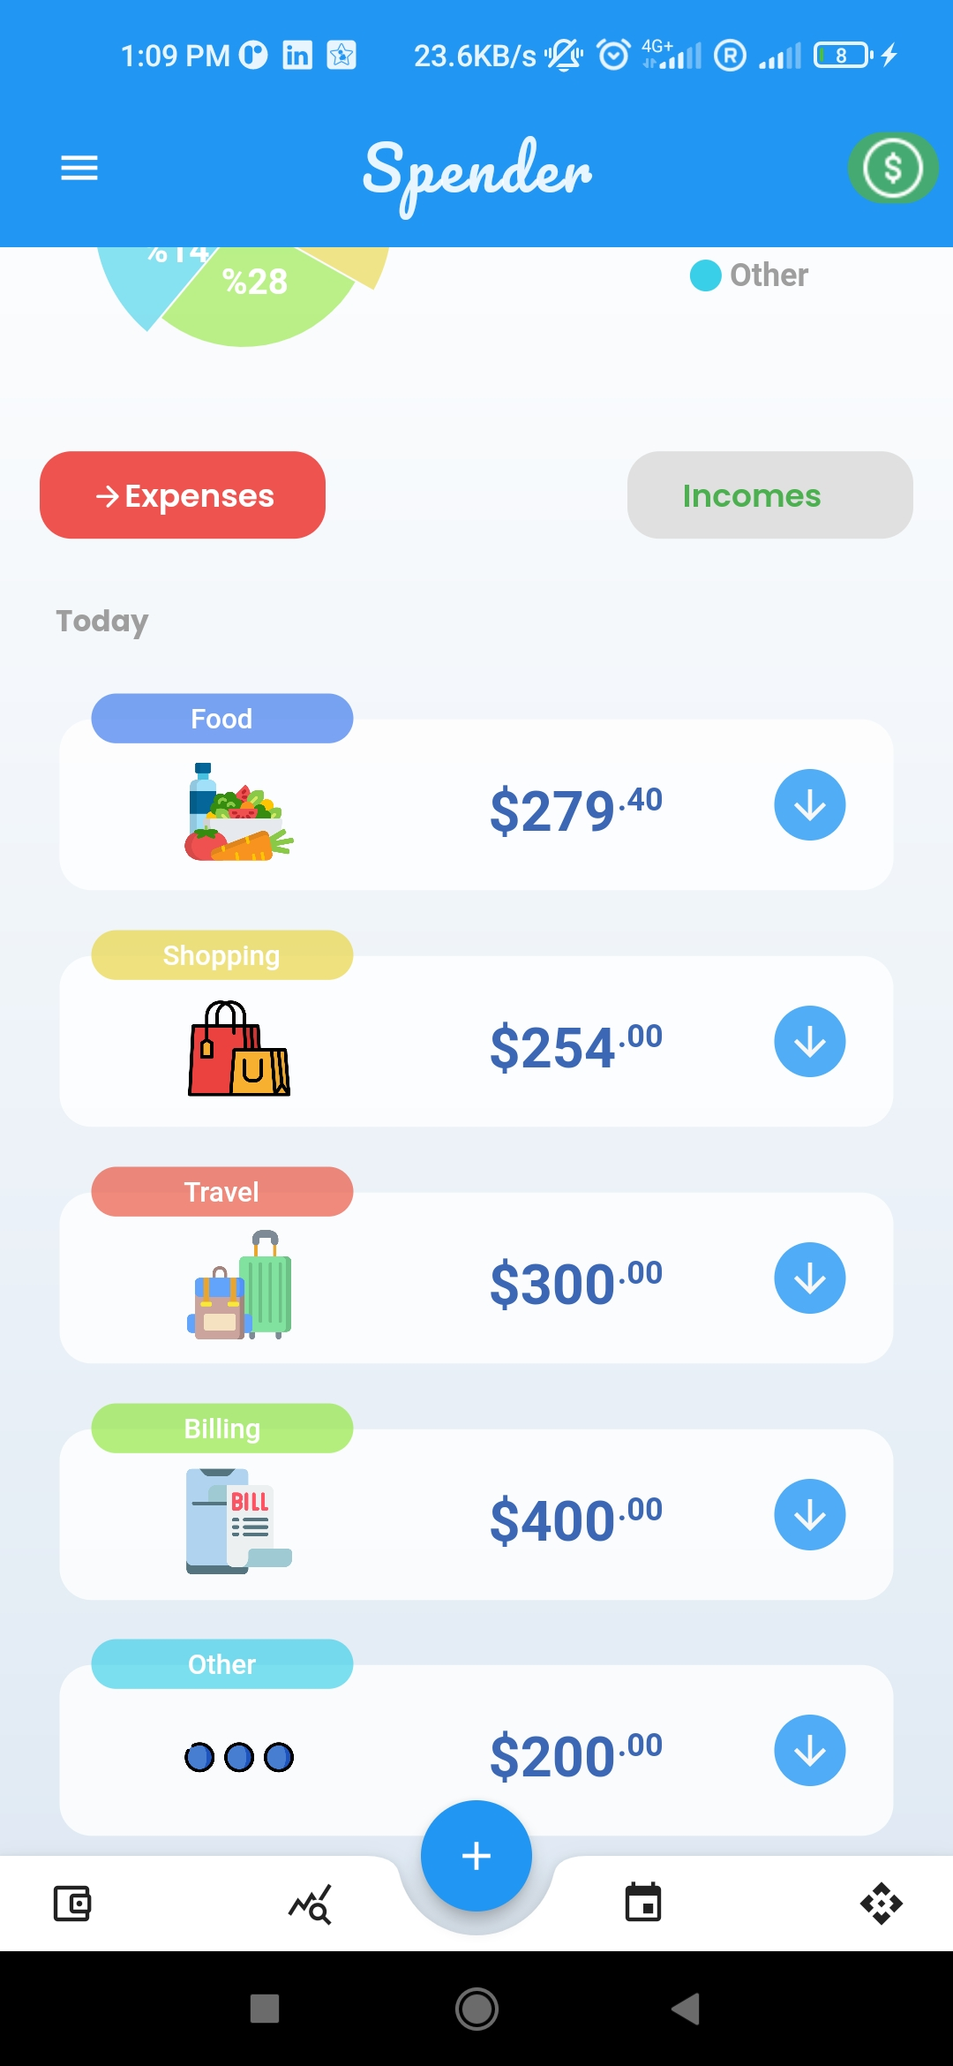
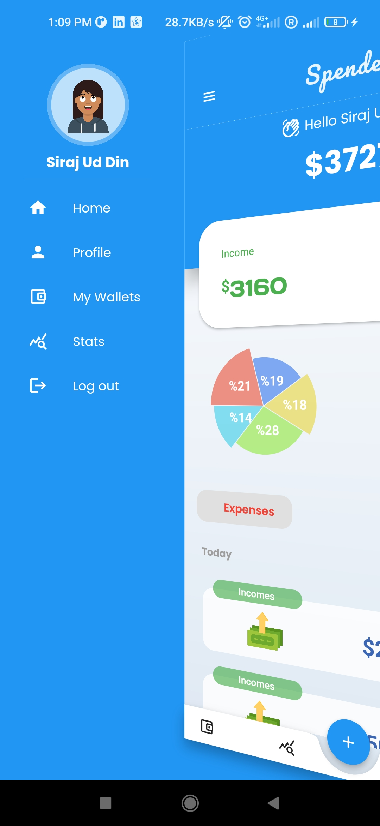
App user interface

Slide 13
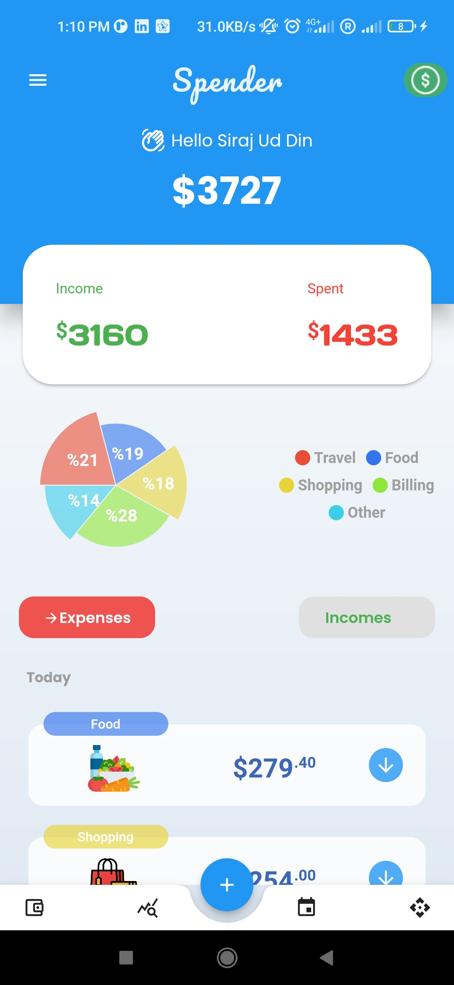
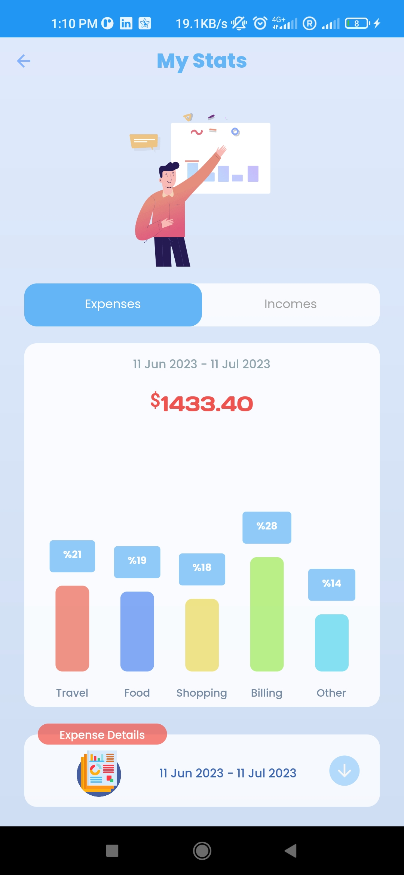
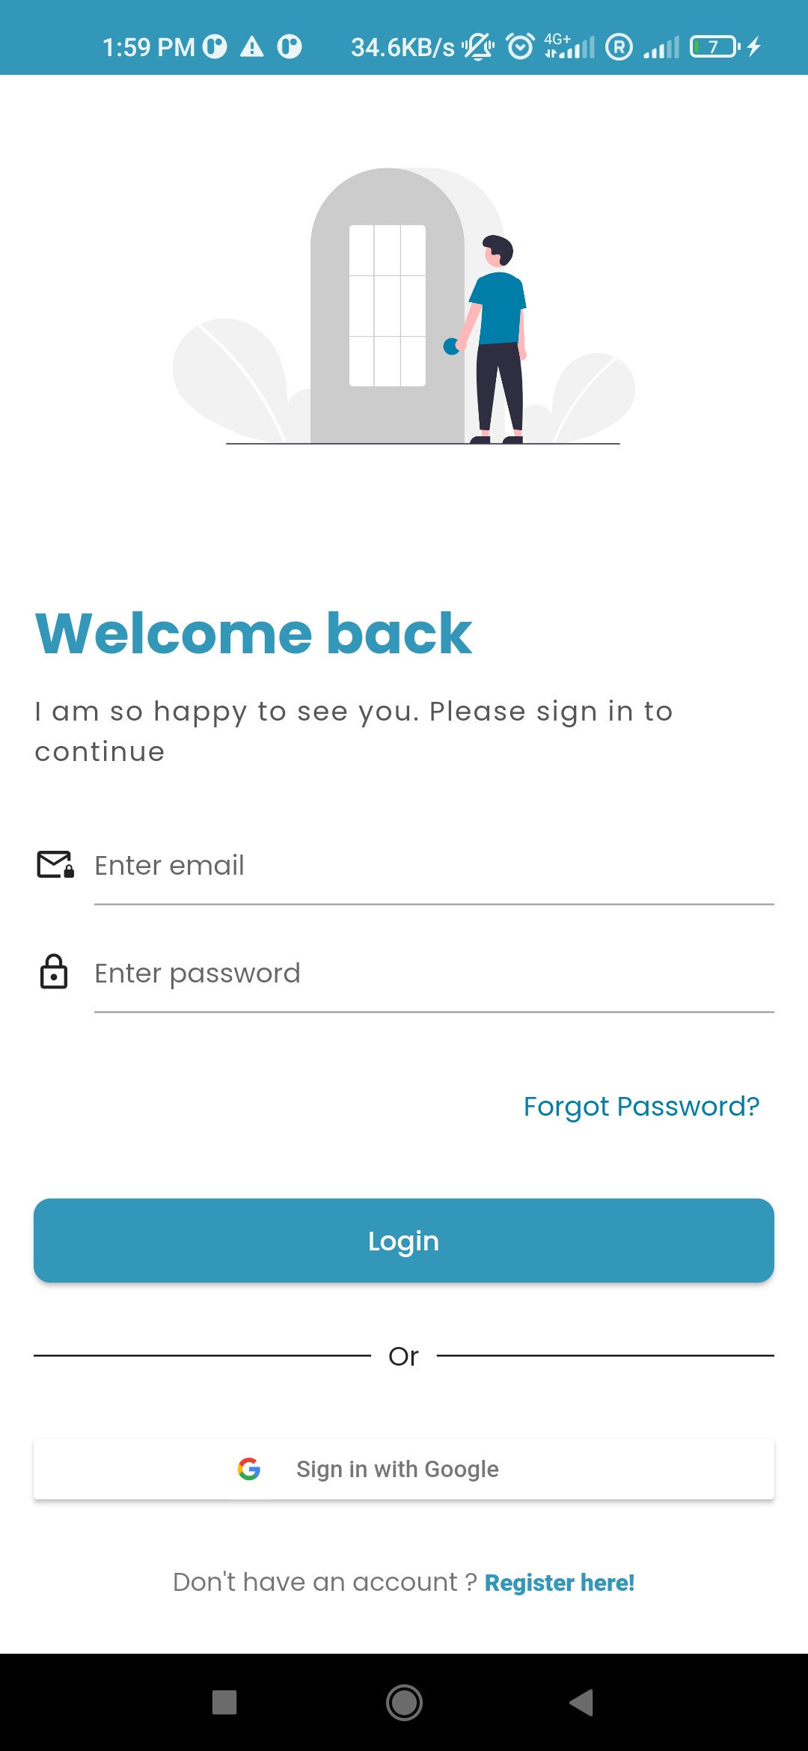
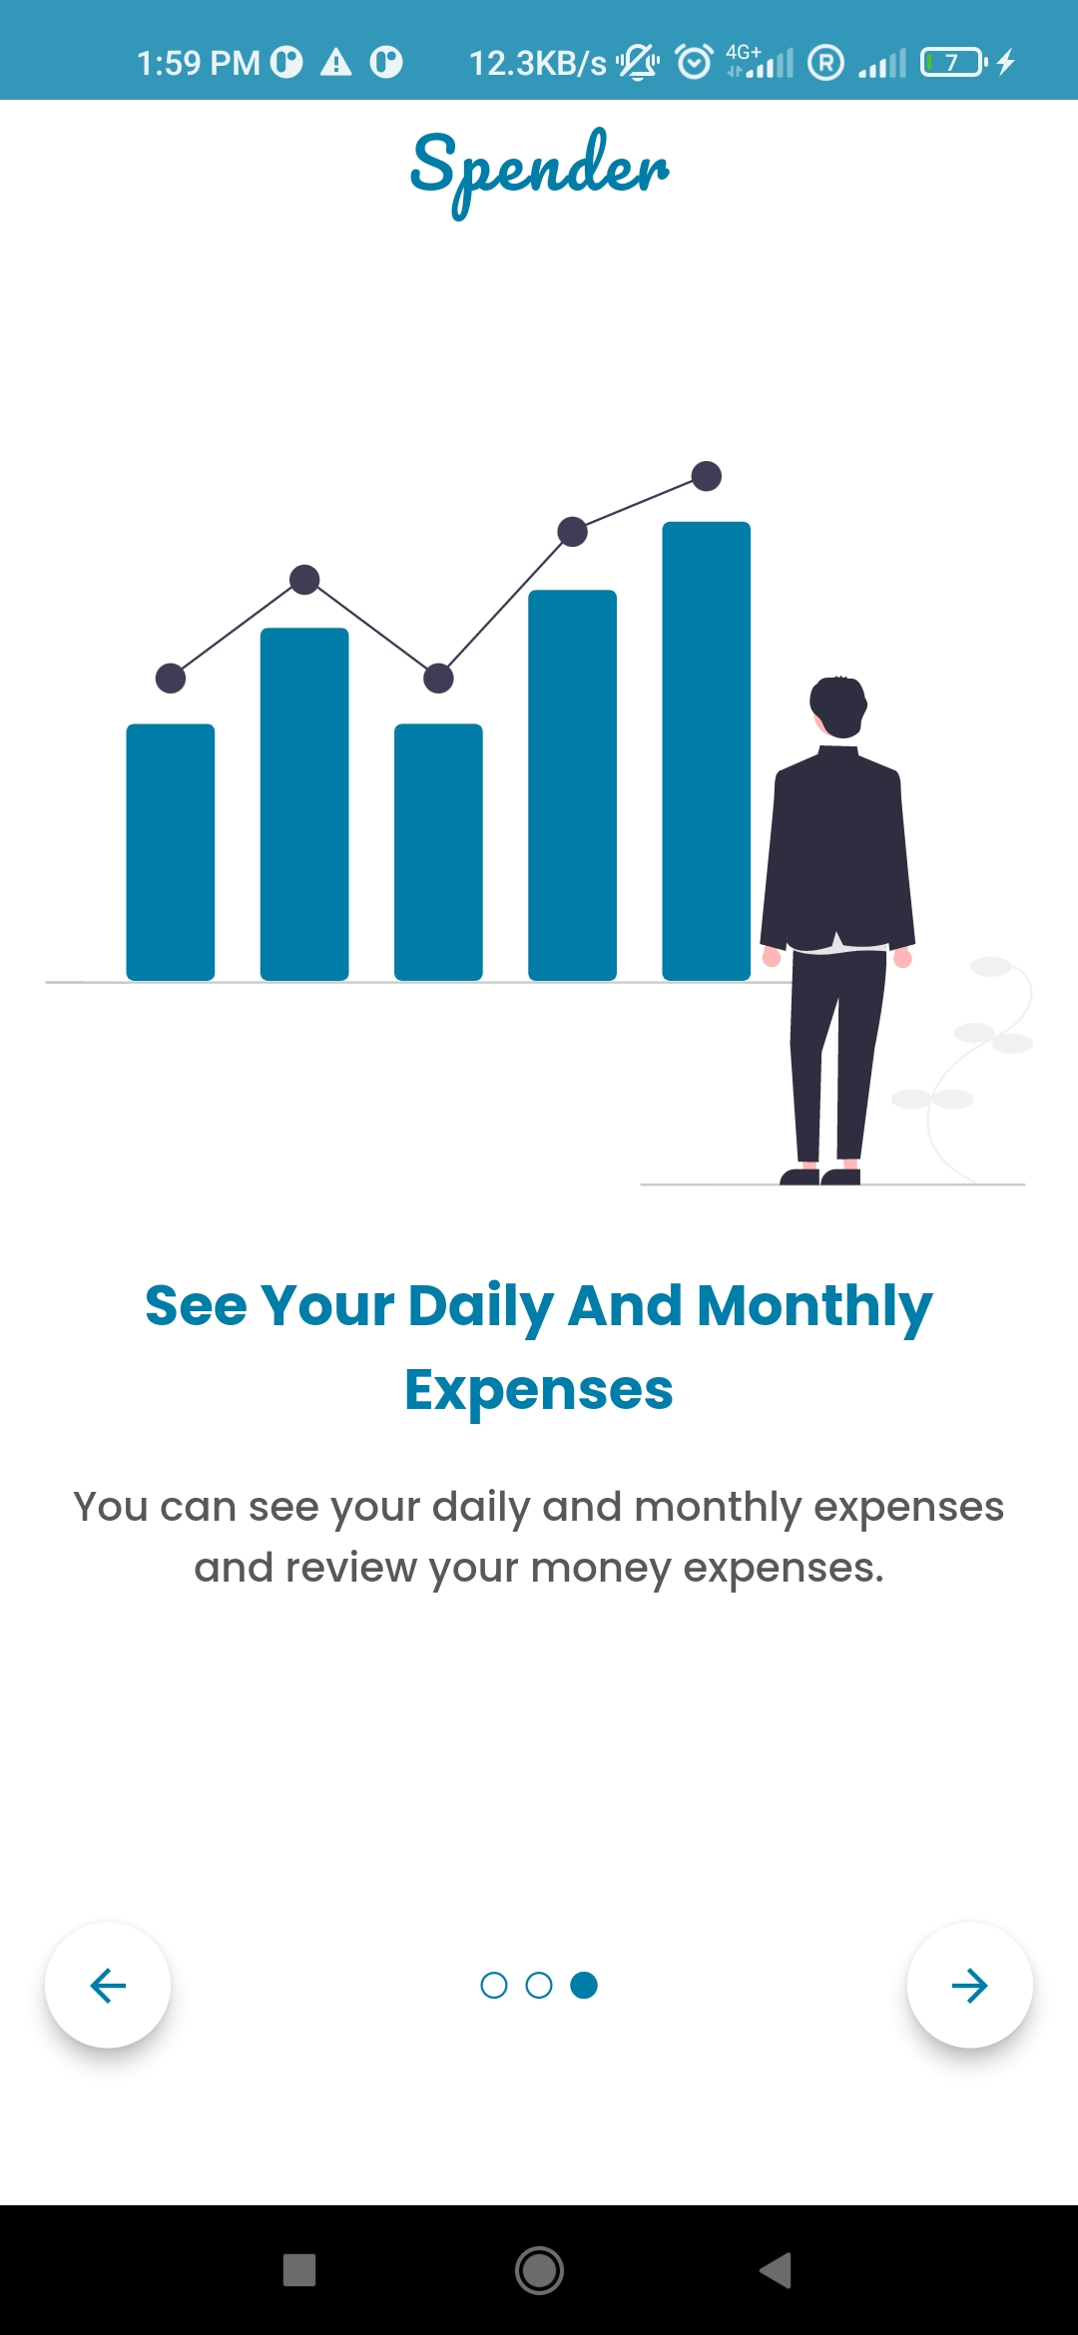
App user interface

Slide 14
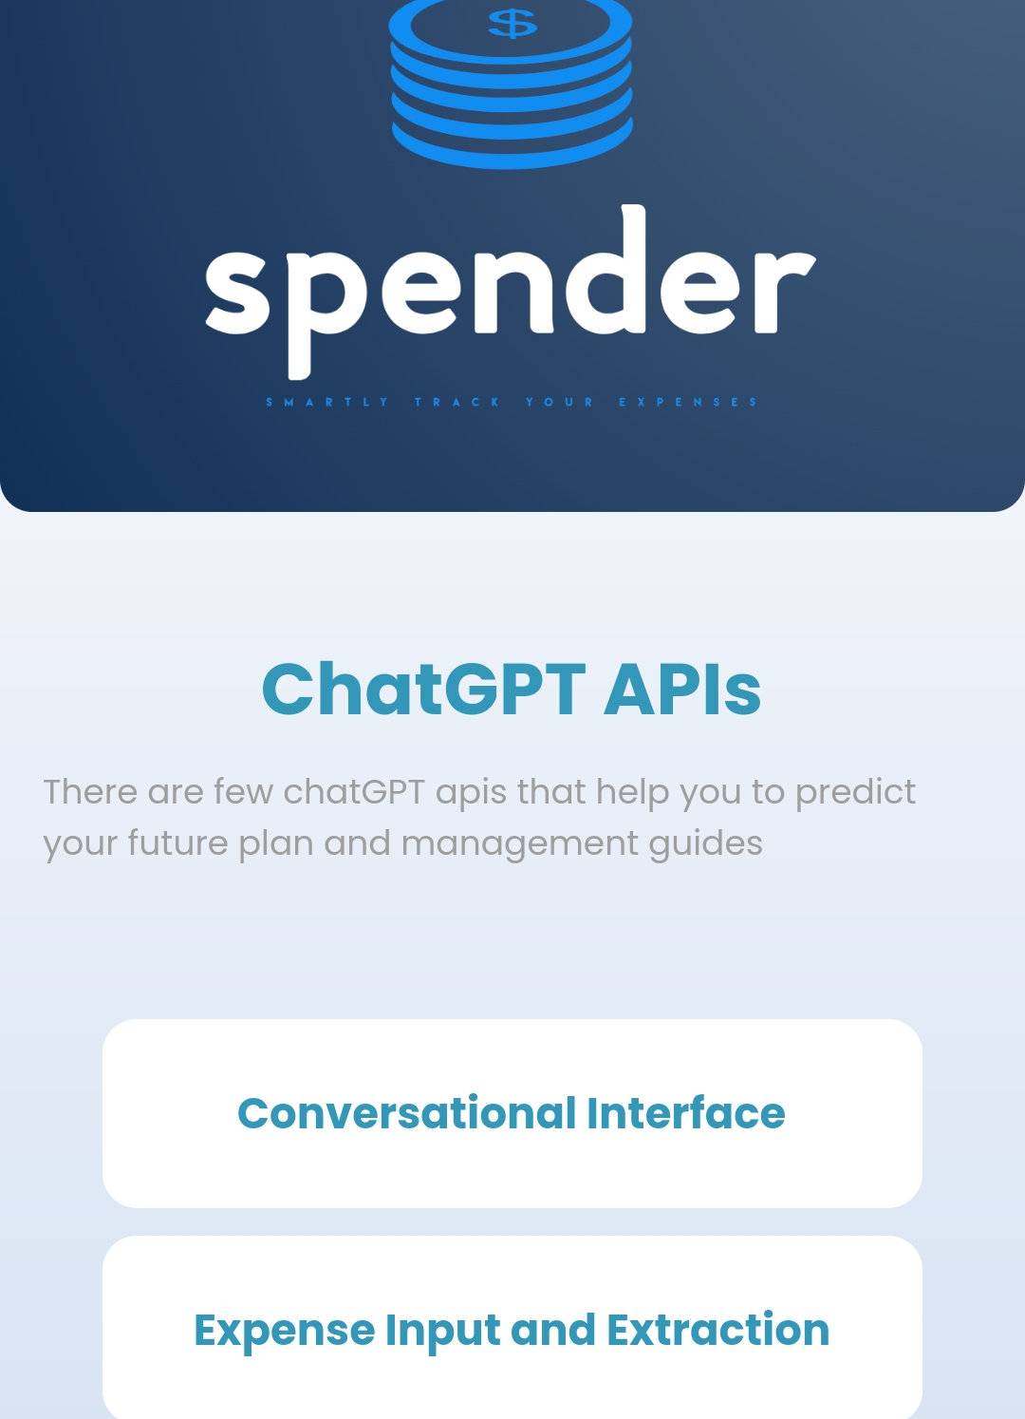
Chatgpt api

Slide 15
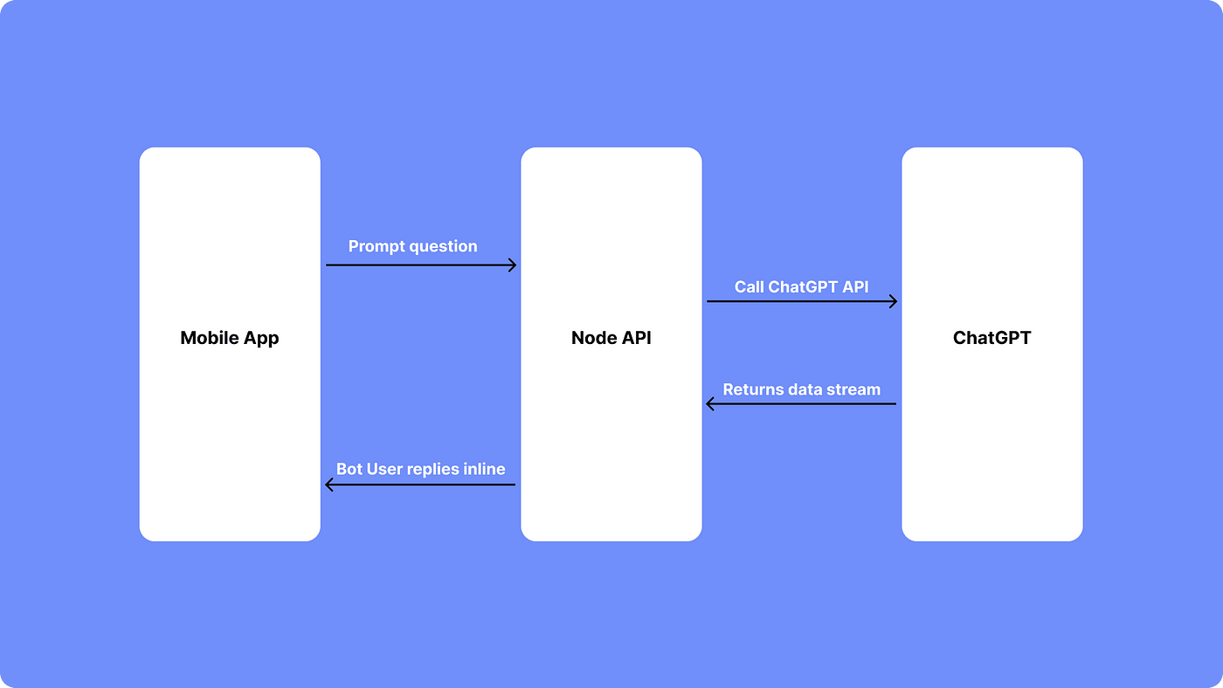
ChatGPT API

Slide 16
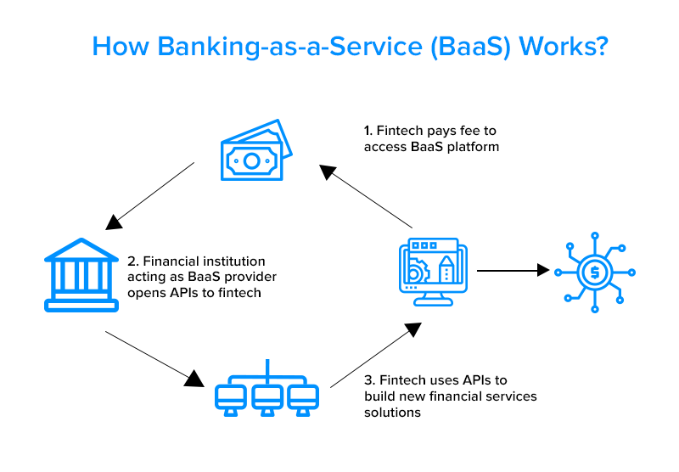

Slide 17

Badge & privilage in business aspect
■Give a badge to a user meeting weekly or monthly goals.
■Each badge can unlock access to functions that need to pay.
■Attract users to use the app more often.
■If users want to get full access, they can pay for the badge.

Slide 18

Thank you

